Slide 1
A safe haven for data in peril VerbaAlpinas' search for rescue and the disovery of "Discover"
02/14/2025
Stephan Lücke
(LMU Center for Digital Humanities [ITG])
Notes:
Hello everybody!
I will now talk about the project VerbaAlpina and its handling of its core project data after the end of the project funding.

Slide 2
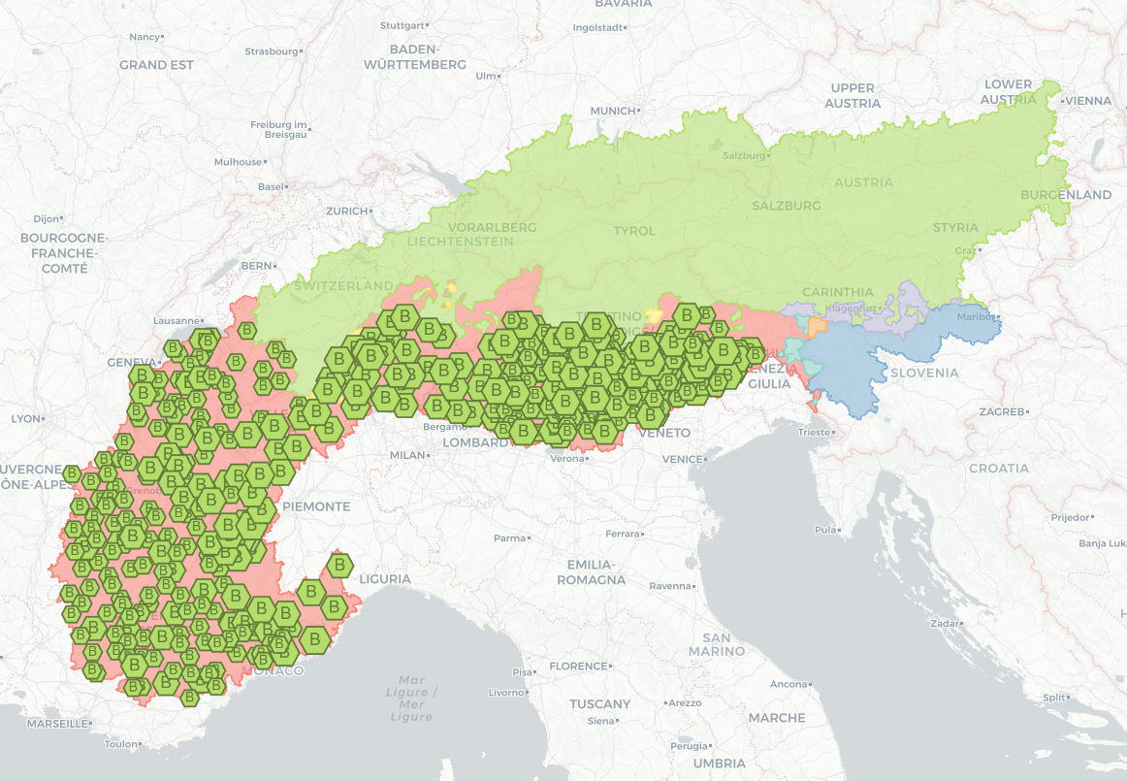
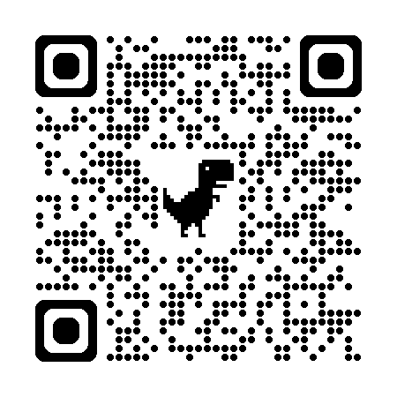
4 Dimensions
Web interface: interactive map
TIME
Concepts
Locations
Trento
burro
BUTTER
https://www.verba-alpina.gwi.uni-muenchen.de/
Words
il burro
Notes:
What is VerbaAlpina about? To put it simply: The project collected words that are used in the Alps to designate specific concepts that are typical for that region.
The usage and meaning of a word can differ from location to location, and its meaning and geographical distribution can change over time.
Therefore, a complex multidimensional dataset emerged. In fact, VerbaAlpina is a dictionary and a linguistic atlas at the same time.
To ensure stability and citability the dataset was versioned every six months throughout the funding period. The latest version represents the state as of the end of 2023. For data visualization, we developed a technically sophisticated interactive online map.

Slide 3
Highly granular and linked data
Wikidata
Dictionaries
(e.g. Treccani)
GeoNames
(ID: 6541469)
Q3376
Q34172
il burro
(VA-ID: L591)
BUTTER
(VA-ID: C156)
Trento
(VA-ID: A19618)
Notes:
The core dataset of VerbaAlpina is very granular. Every single item - be it a word, a concept, or a location - can be precisely referenced by an ID and a corresponding internet address.
All individual items are linked within the project dataset and, where possible, also to external norm data systems such as Wikidata, GeoNames or online dictionaries.

Slide 4
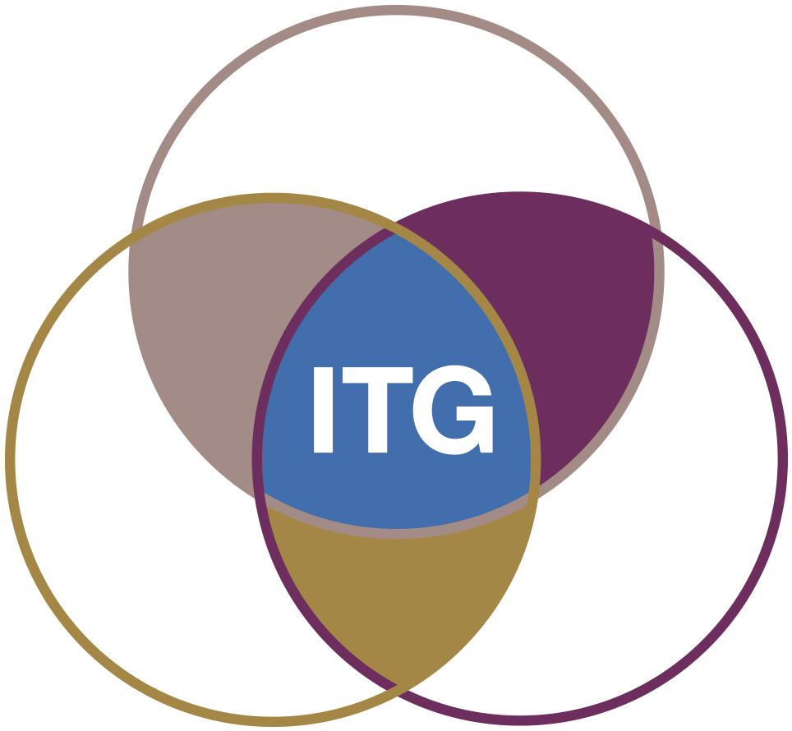
Out on sea: Risky voyage on borrowed ship
?
Interfaces
Core
project
data
PMA
Core
project
data
GUI (i. a. map)
Library
API
Solid ground
Funding
Staff & Infrastructure
Notes:
VerbaAlpina was funded as a long term project by the German Research Fund DFG from 2014 to 2023.
Like every other third-party funded project also VerbaAlpina had to face the question what would happen to its core project data after the funding ended. The project’s legacy exclusively consists of electronic data. Almost nothing was published on paper.
Electronic data requires continuous maintenance and depends on staff and infrastructure. VerbaAlpina chose the university library as the future caretaker. The library seems ideal, as it has an indefinite lifespan and provides the necessary expertise and infrastructure. For centuries, the libraries have been responsible for preserving knowledge.
The data transfer was organised and conducted in close cooperation between the ITG and the library. At the library, the data was ingested into the system “Discover”.
So far, preserving the project’s multifold and complex interfaces of the project remains an unsolved problem.

Slide 5
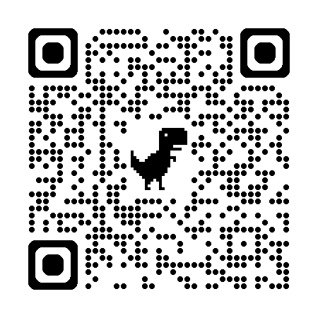
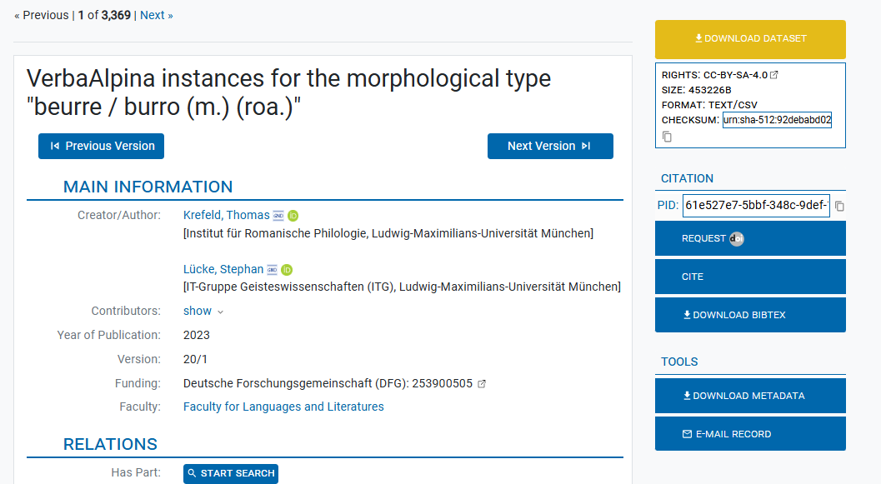
- Record interface
Download of record
burro
(PID, DOI)
DOI – on request
Wikidata
Q34172
Project
data
…
Geonames
(ID:6452091)
Solid ground
…
VerbaAlpina-ID
PID
Notes:
Within Discover, the VerbaAlpina project data has retained its fine granularity. Each record is assigned an individual persistent identifier (PID) and can be precisely referenced via a stable URL. Upon request, also a DOI is made available for each record. This applies to all the central entities – whether the words, the concepts or the locations. Thanks to the stability and reliability of the university library, these links are likely to remain functional for a very long time.
Each record’s interface displays all the metadata associated with the selected item. All the internal and external correlations are also preserved. Interactive links direct users to the corresponding web pages. For example, clicking on the keyword “BUTTER” on the displayed record opens the corresponding web page within Discover. There, with shifted focus, all data corresponding to the key word BUTTER is displayed.
The dataset is structured into three levels with varying granularity. Level 1 encompasses the entire dataset of a VerbaAlpina version. At each level data can be downloaded in CSV format.
Discover is a relatively new service. The university library and the ITG maintain close and regular contact to continuously improve the service and address emerging issues or existing errors.

Slide 6
Key takeaways
Electronic project data MUST remain stable and accessible indefinitely
If applicable, project data should be highly granular and accessible via stable URLs
An institution responsible for maintaining the data is indispensable
The responsible institution MUST have an unlimited life expectancy
The responsible institution MUST have a solid and unconditional funding
At LMU the university library meets these requirements
The framework „Discover“ can be a suitable technical solution
Notes:
Here are the key takeaways:
Electronic project data MUST remain stable and accessible indefinitely
If applicable, project data should be highly granular and accessible via stable URLs
An institution responsible for maintaining the data is indispensable
The responsible institution MUST have an unlimited life expectancy
The responsible institution MUST have a solid and unconditional funding
At LMU the university library meets these requirements
The framework „Discover“ can be a suitable technical solution

Slide 7
Thank you for your attention!
Dr. Stephan Lücke
LMU Center for Digital Humanities
luecke@lmu.de
Notes:
Thank you for your attention!

